Slide 1
Operators

Slide 2
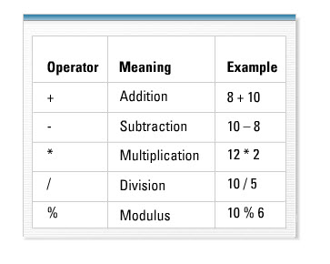
Arithmetic Operator

Slide 3
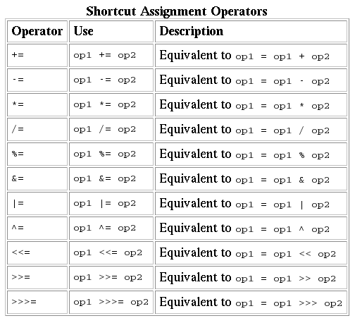
Shortcut Assignment Operator

Slide 4
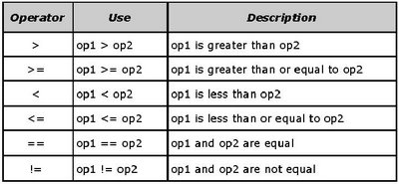
Relational Operator

Slide 5
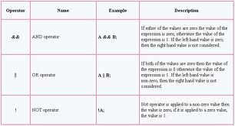
Logical Operator

Slide 6
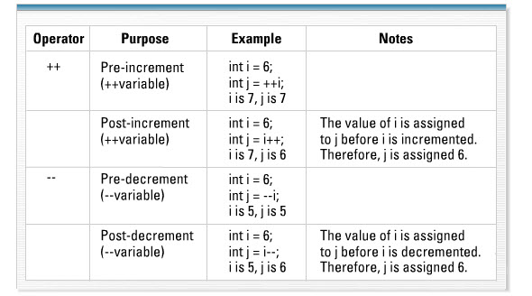
Increment or Decrement Operator

Slide 7
Ternary Operator
result = testCondition ? value1 : value2

